Slide 1
PHP AJAX
AJAX = Asynchronous JavaScript and XML.
AJAX is a technique for creating fast and dynamic web pages.

Slide 2
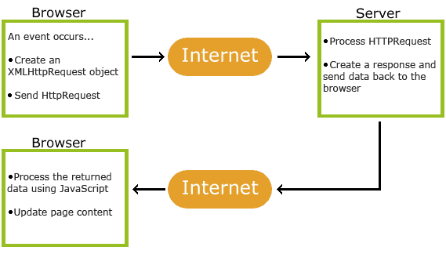
AJAX Works

Slide 3
AJAX is Based on Internet Standards
XMLHttpRequest object (to exchange data asynchronously with a server)
JavaScript/DOM (to display/interact with the information)
CSS (to style the data)
XML (often used as the format for transferring data)

